Slide 1



Bringing Power BI into the Dataverse through the Magic of Synapse
Scott Sewell
Principal Program Manager
Power BI Customer Advisory Team (PBICAT)

Slide 2
SQL Data Export Service
Effective November 2021, the SQL Data Export Service was deprecated.
Data Export Service will continue to work and will be fully supported until it reaches end-of-support and end-of-life in November 2022.
More information: https://aka.ms/DESDeprecationBlog
Way more information: https://aka.ms/DESDeprecationPlaybook

Slide 3

Basic Dataverse to Power BI Choices
1) Direct Query using Dataverse Connector
Report Design and Data Model

Slide 4
Basic Dataverse to Power BI Choices
Report Design and Data Model
2) Import mode using Dataverse Connector
Vertipaq

Slide 5
Basic Dataverse to Power BI Choices
Report Design and Data Model
Vertipaq
3) Import from Synapse Analytics SQL

Slide 6
Basic Dataverse to Power BI Choices
1) Direct Query using Dataverse Connector
Report Design and Data Model
2) Import mode using Dataverse Connector
Vertipaq
3) Import from Synapse Analytics SQL

Slide 7
Basic Dataverse to Power BI Choices
Report Design and Data Model
Vertipaq
3) Import from Synapse Analytics SQL

Slide 8
What is Synapse Link for Dataverse?
Azure Synapse Analytics
Auto-Created Views
Azure Synapse Link for Dataverse
Power BI
Azure Data Lake Storage
https://docs.microsoft.com/en-us/powerapps/maker/data-platform/export-to-data-lake

Slide 9
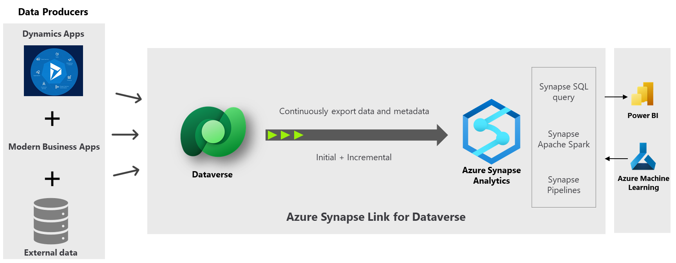
Why Synapse Link for Dataverse?

Slide 10
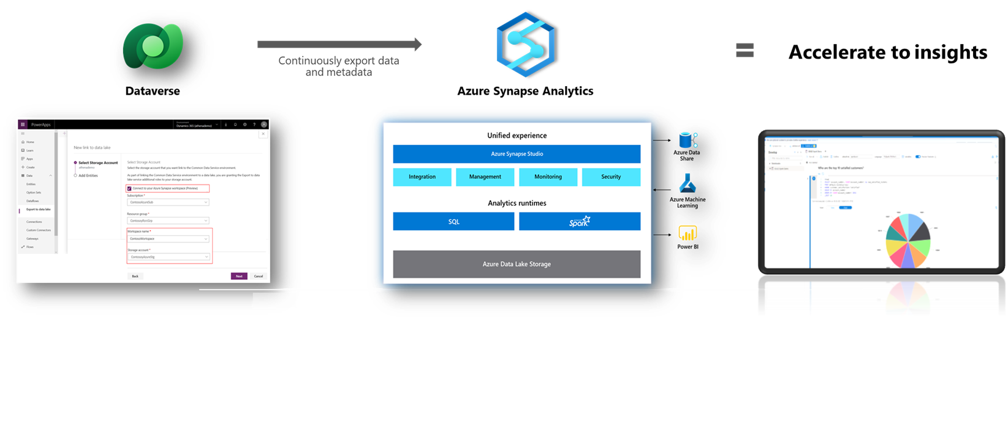
Why Synapse Link for Dataverse?
Democratize Dataverse data and enable advanced analytics to accelerate time to insights…
A single, end-to-end way to work with data in Microsoft Dataverse, from running AI and machine learning, integrating with external datasets, and slicing and dicing large volumes of Dataverse data.
Instead of using multiple tools to get the job done, you can accelerate time-to-insight with a single comprehensive solution that can help you deliver on these goals end-to-end; built-in and available out-of-the-box

Slide 11
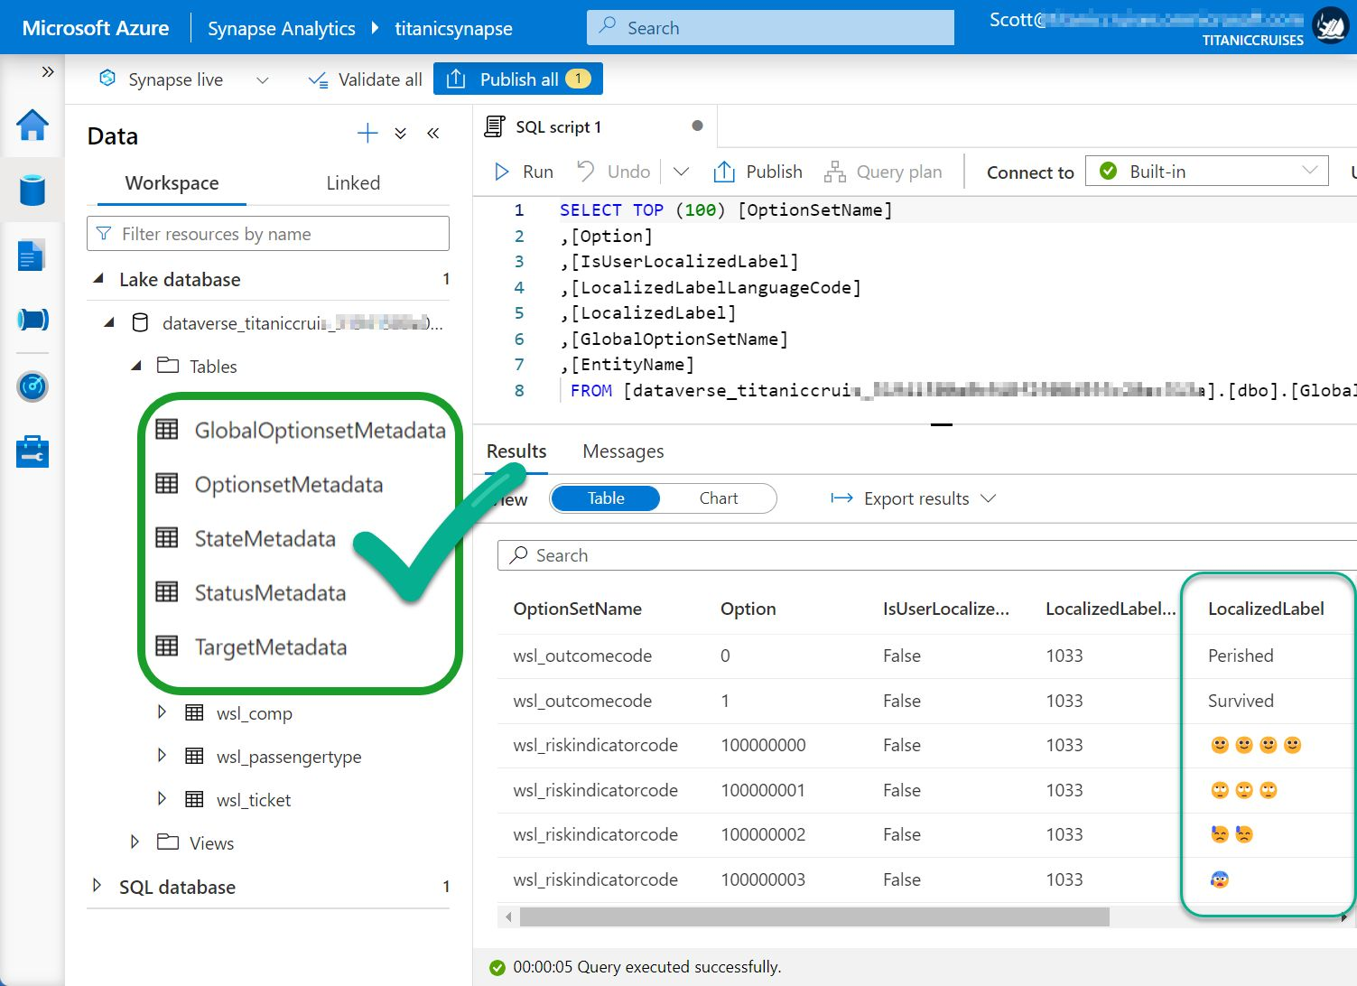
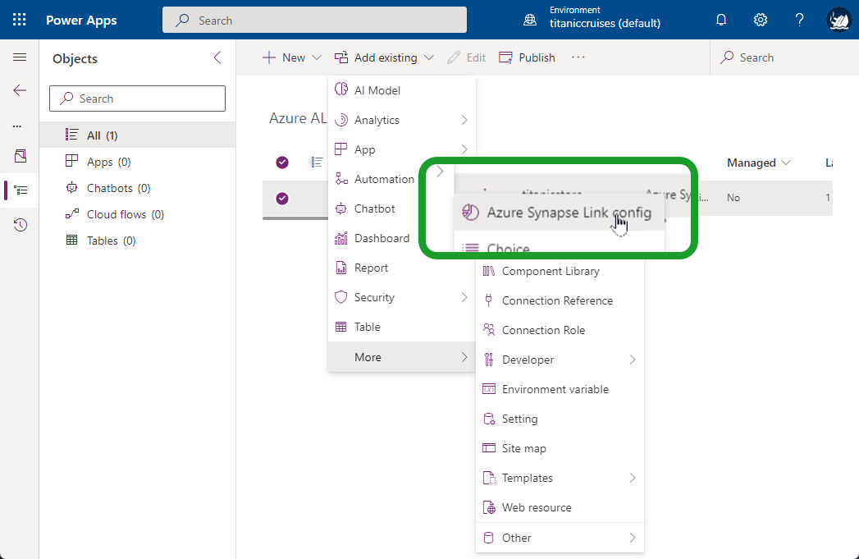
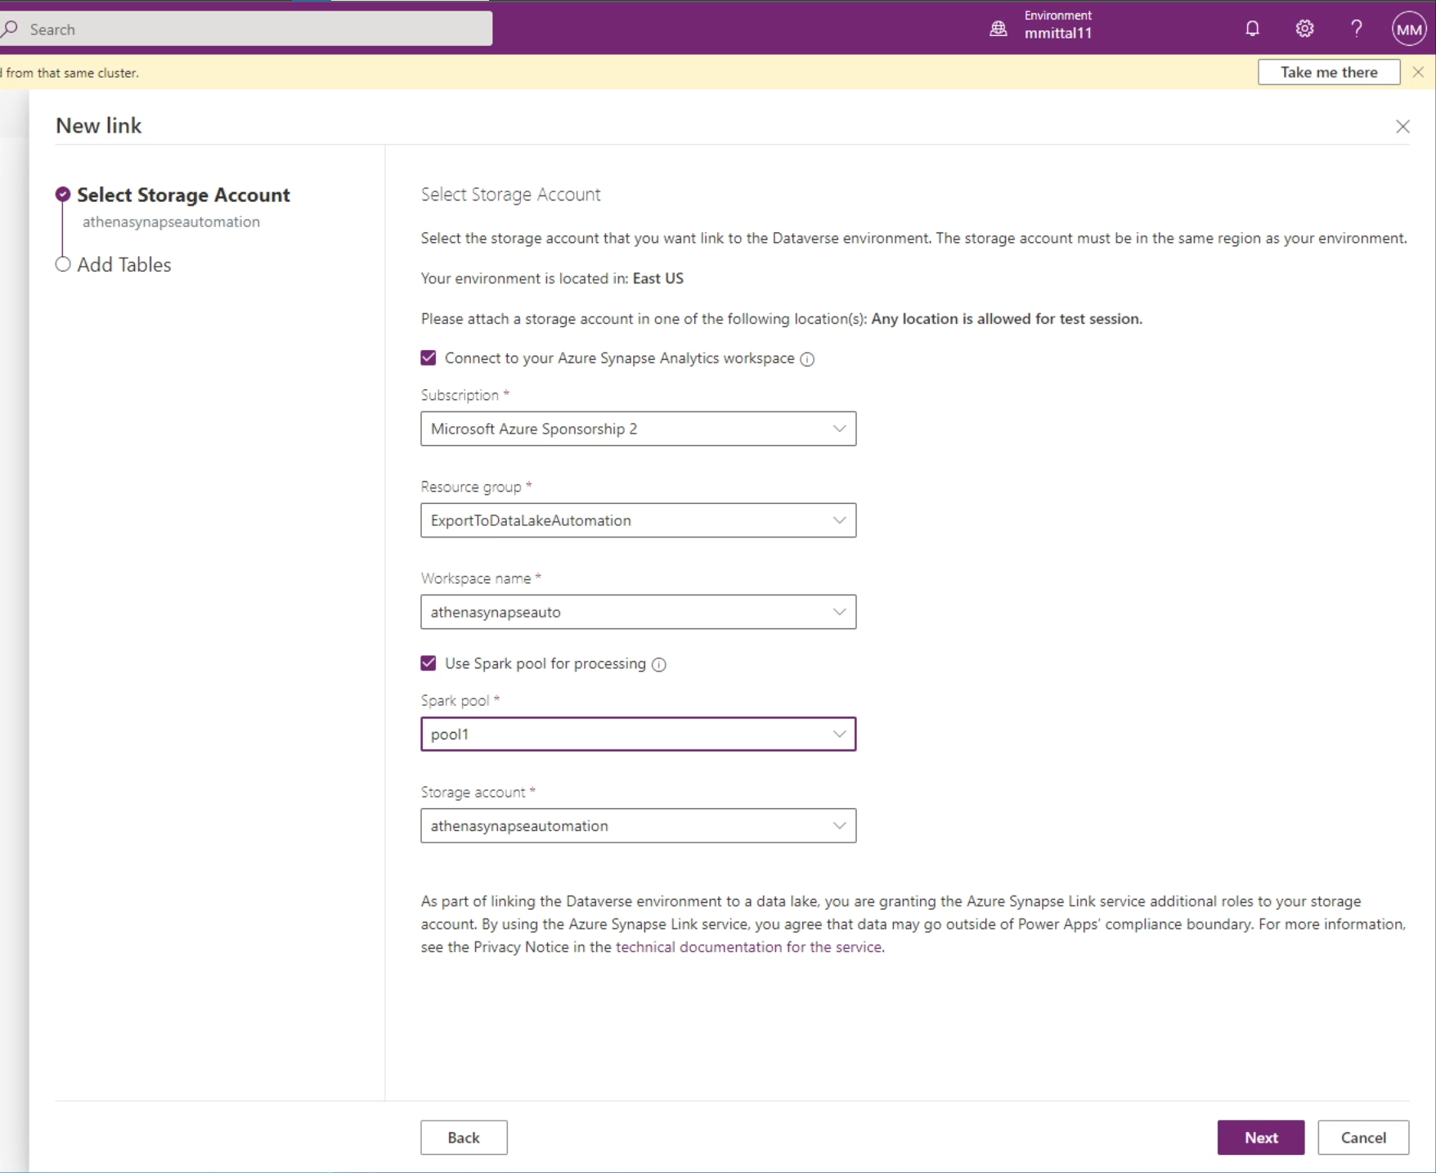
Features: New for Synapse Link in Dataverse
Coming Soon!
Access Dataverse choice labels directly from Azure Synapse Link for Dataverse
Transport the Azure Synapse Link for Dataverse configuration across environments
Query and analyze incremental updates using Parquet and Delta Lake format

Slide 12
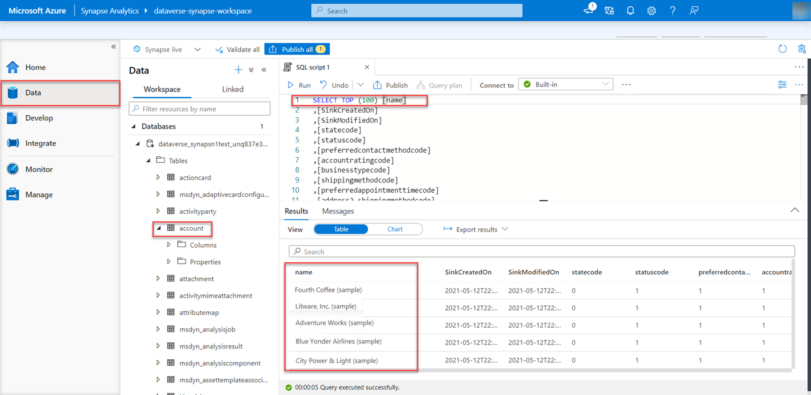
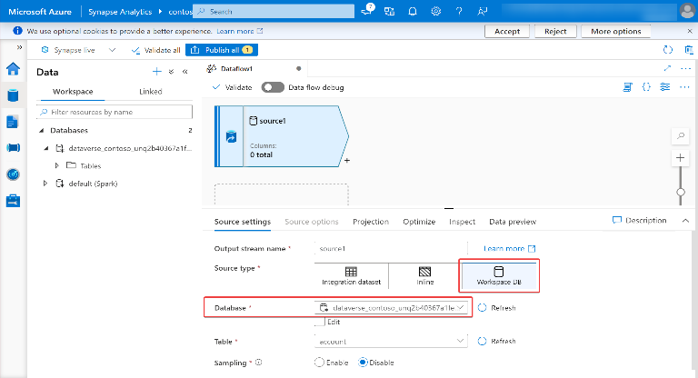
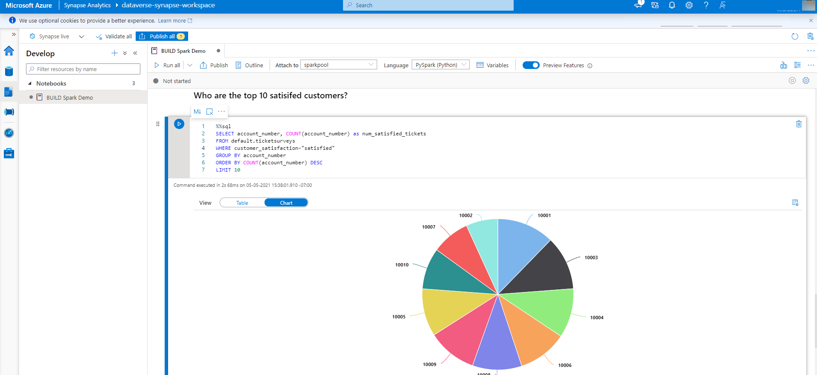
Ready to run experiences in Azure Synapse Analytics
Built-in capabilities for data ingestion, data preparation and machine learning
Ready to run Synapse Serverless SQL query experience
Ready to run Synapse Pipelines query experience
Ready to run Synapse Spark query experience

Slide 13
Azure Synapse Link for Dataverse
Azure Synapse Analytics
Auto-Created Views
Azure Synapse Link for Dataverse
Power BI
Azure Data Lake Storage

Slide 14
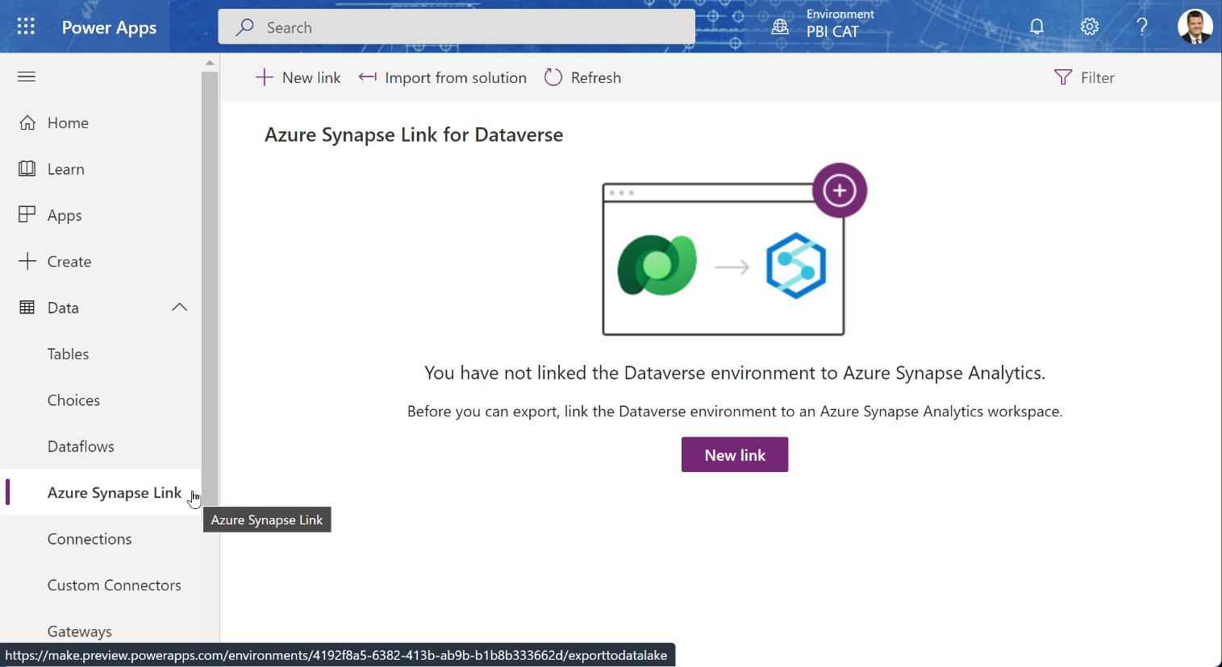
Setup of Synapse Link
Power Apps Administration Page
Https://make.PowerApps.Com

Slide 15
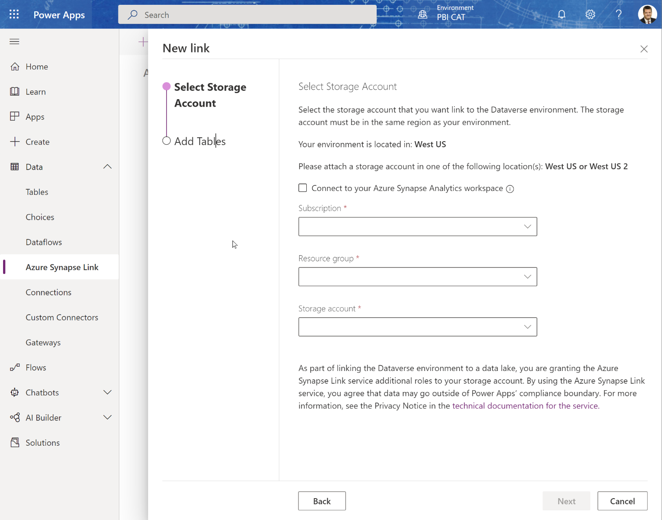
Create Synapse Link
Choose the Storage account and Synapse workspace:
If you already have a Synapse Workspace, click the checkbox to connect to the existing workspace.

Slide 16
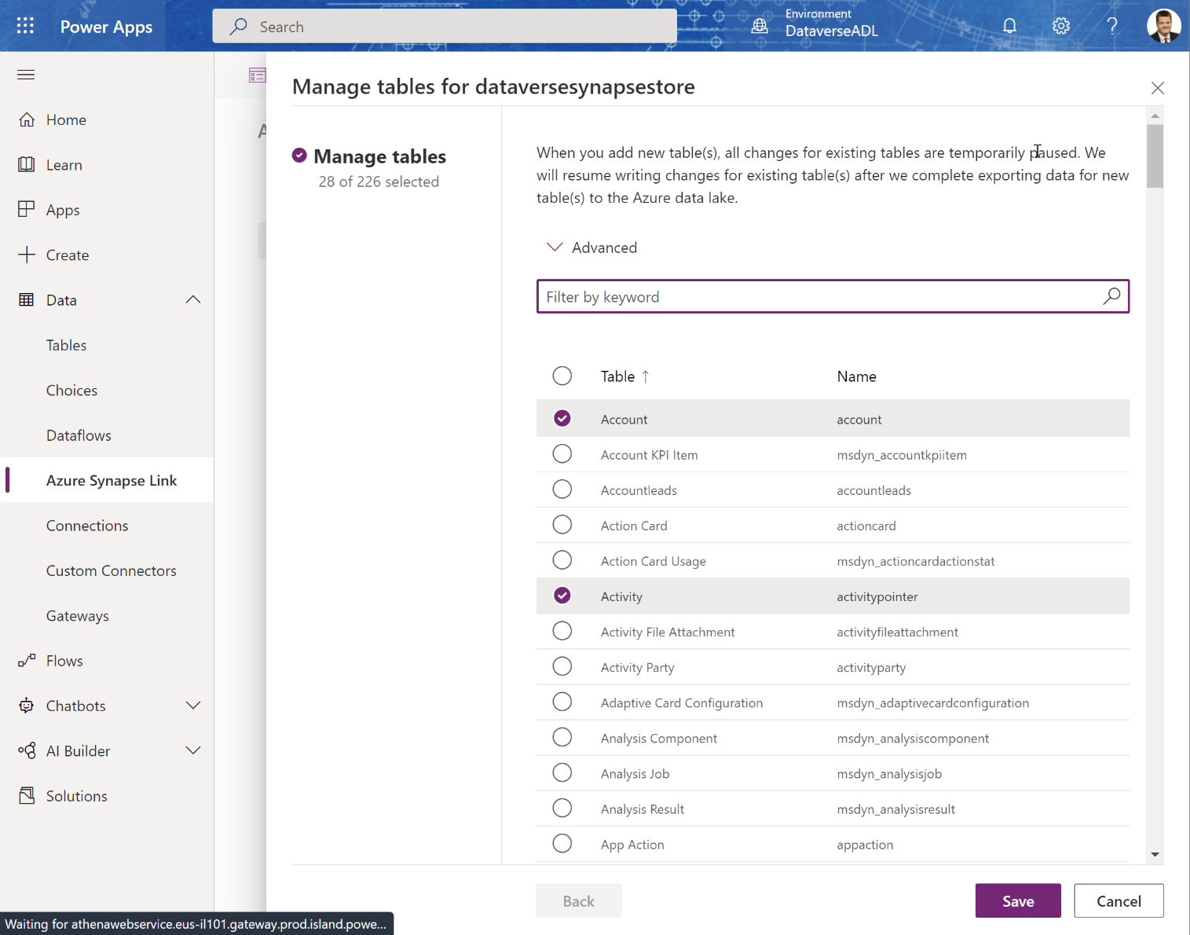
Choose Tables
Choose the tables you want to sync to the Azure data lake – (you can add more later.)

Slide 17
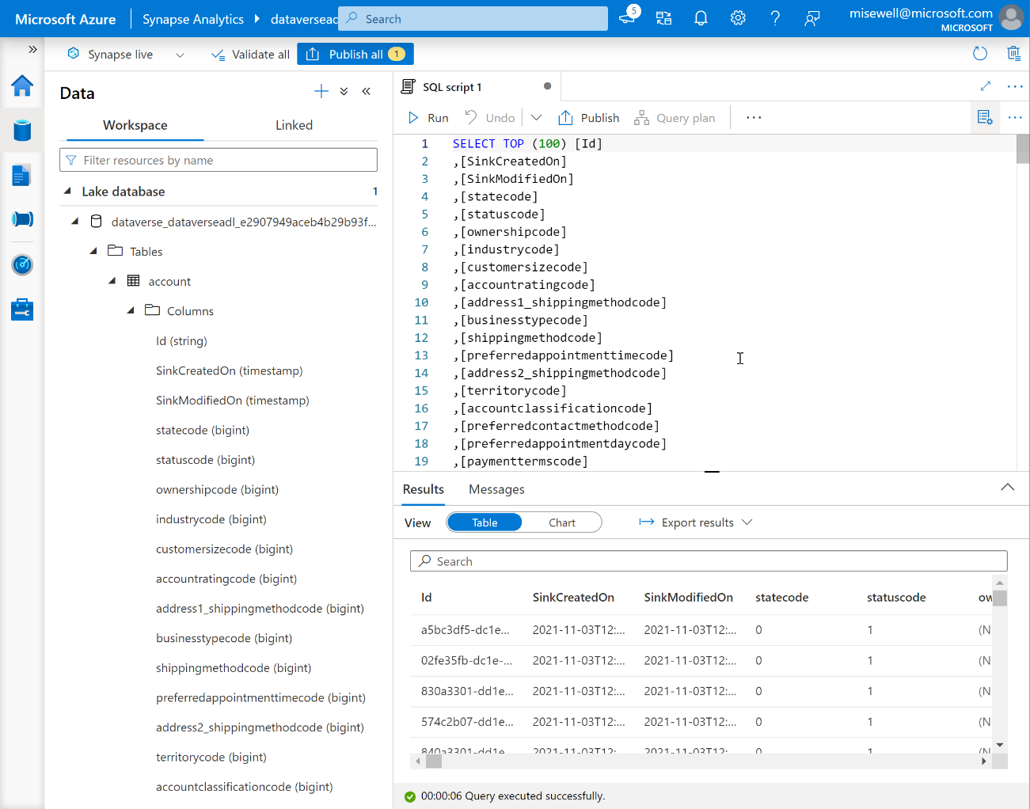
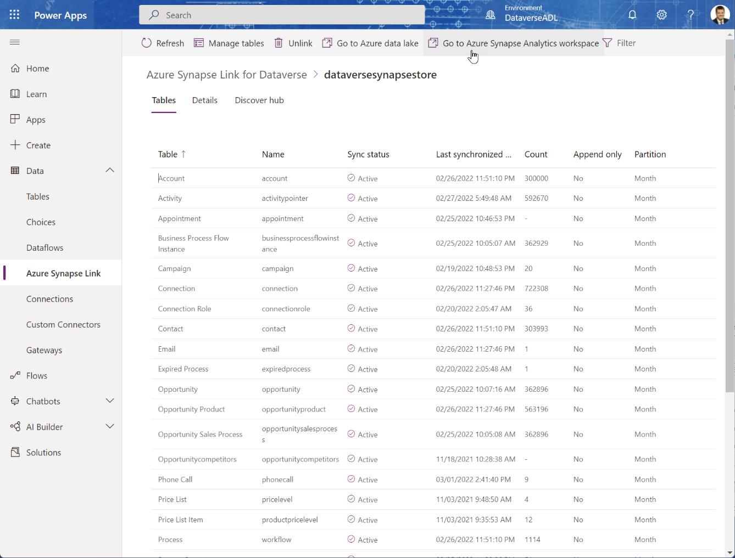
Open Synapse Workspace

Slide 18
What is Synapse Link for Dataverse
Azure Synapse Analytics
Auto-Created Views
Azure Synapse Link for Dataverse
Power BI
Azure Data Lake Storage

Slide 19
Azure Synapse Link for Dataverse
Azure Synapse Analytics
Auto-Created Views
Custom Report Views
Azure Synapse Link for Dataverse
Power BI
Azure Data Lake Storage

Slide 20
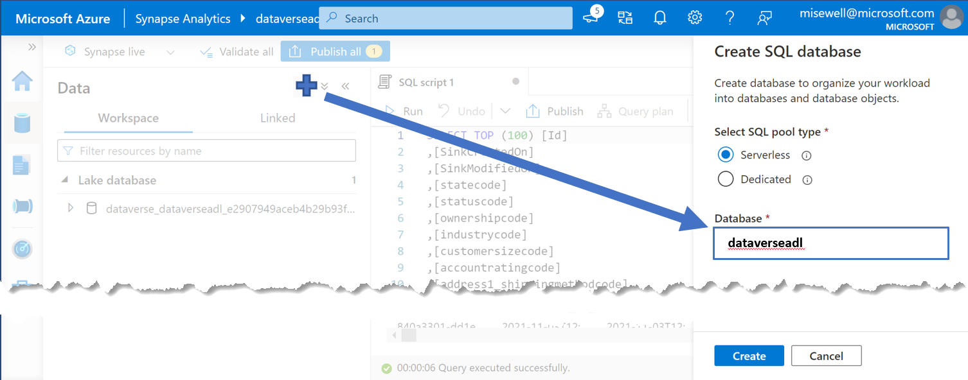
Create a companion Serverless SQL Database for Views
The ServerlessSQL DB auto-created by the Synapse Link is read-only.
Although you could point Power BI directly to it, creating a 2nd ServerlessSQL DB to hold your own configured views for reports give you flexibility to create a simpler and ‘cleaner’ data source.
Azure Synapse Analytics – ServerlessSQL
Azure Synapse Link for Dataverse
Azure Data Lake Storage
Custom Report Views
Auto-Created Views

Slide 21
Use the metadata views to access the “Choice” Labels from Dataverse
The auto-created table views only return the numeric value associated with ‘Choice’ fields, State Code or Status Reason.
In a view, join the base table to the appropriate Metadata table to retrieve the needed label.
Documentation is here: Access Dataverse choice labels directly from Azure Synapse Link for Dataverse - Power Apps

Slide 22
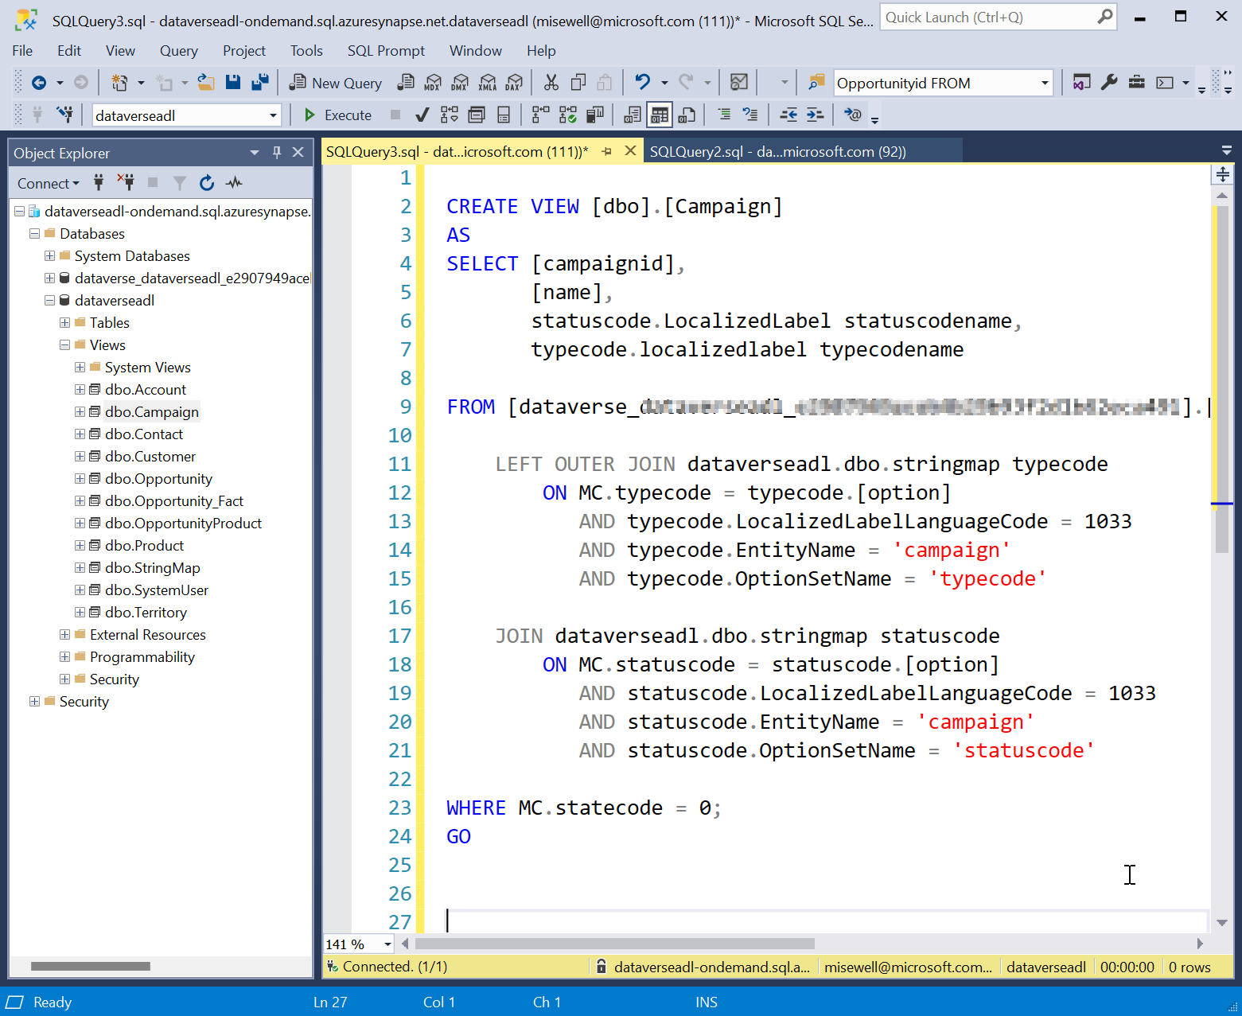
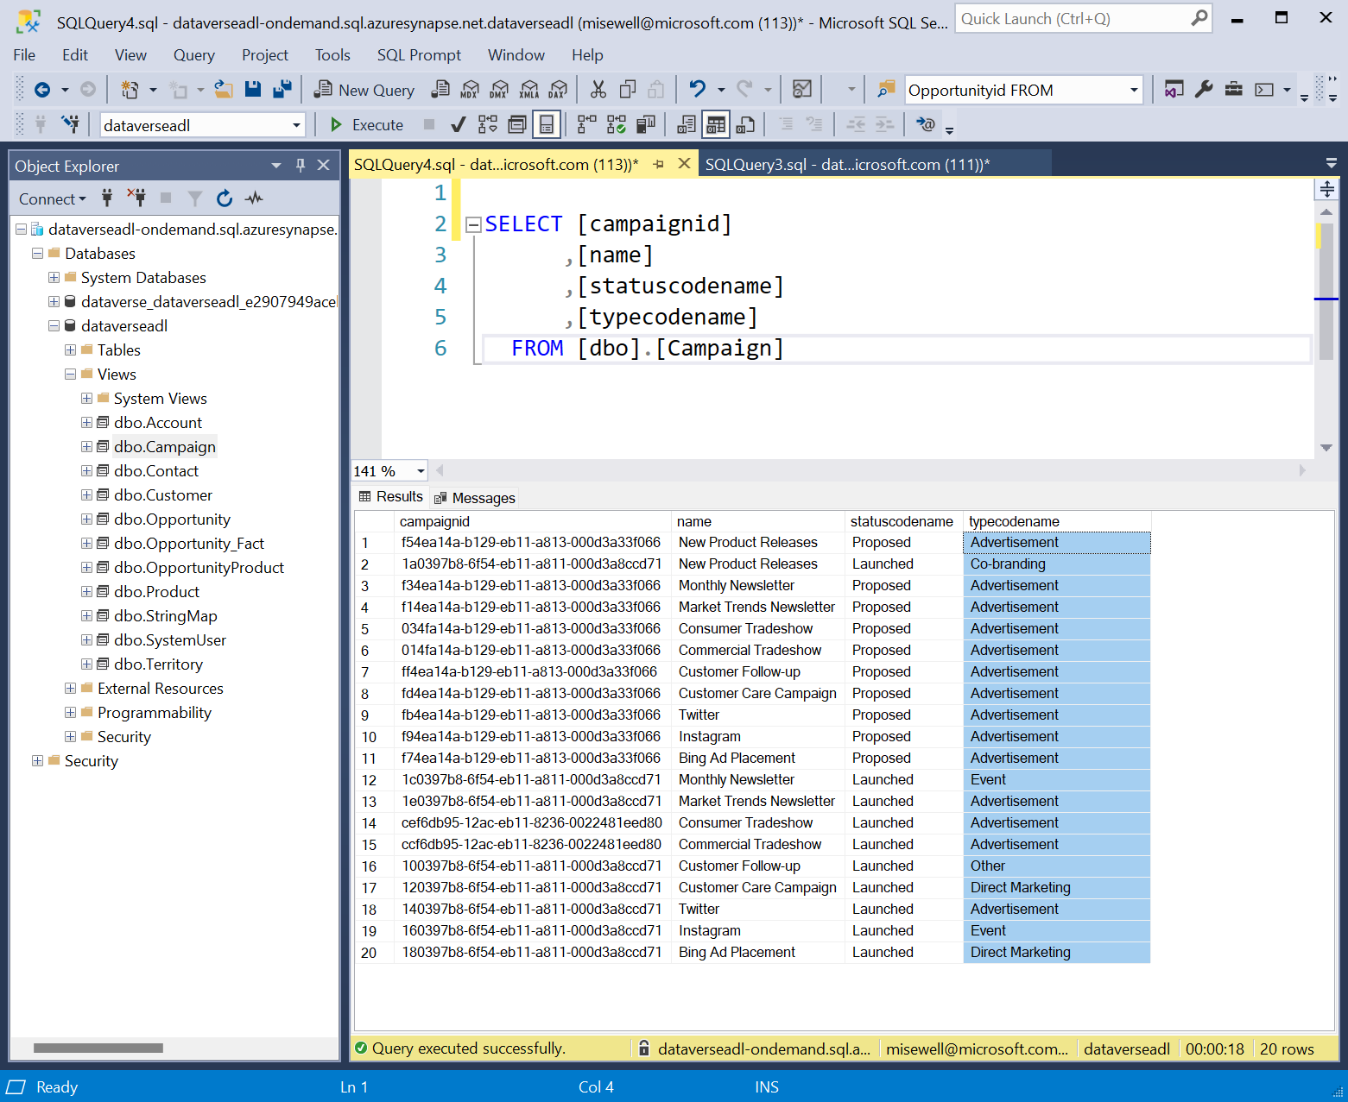
Create views for use as your report source.
Remove unneeded records and columns. Use the metadata views to resolve the choice labels and make it easier for your builders.

Slide 23
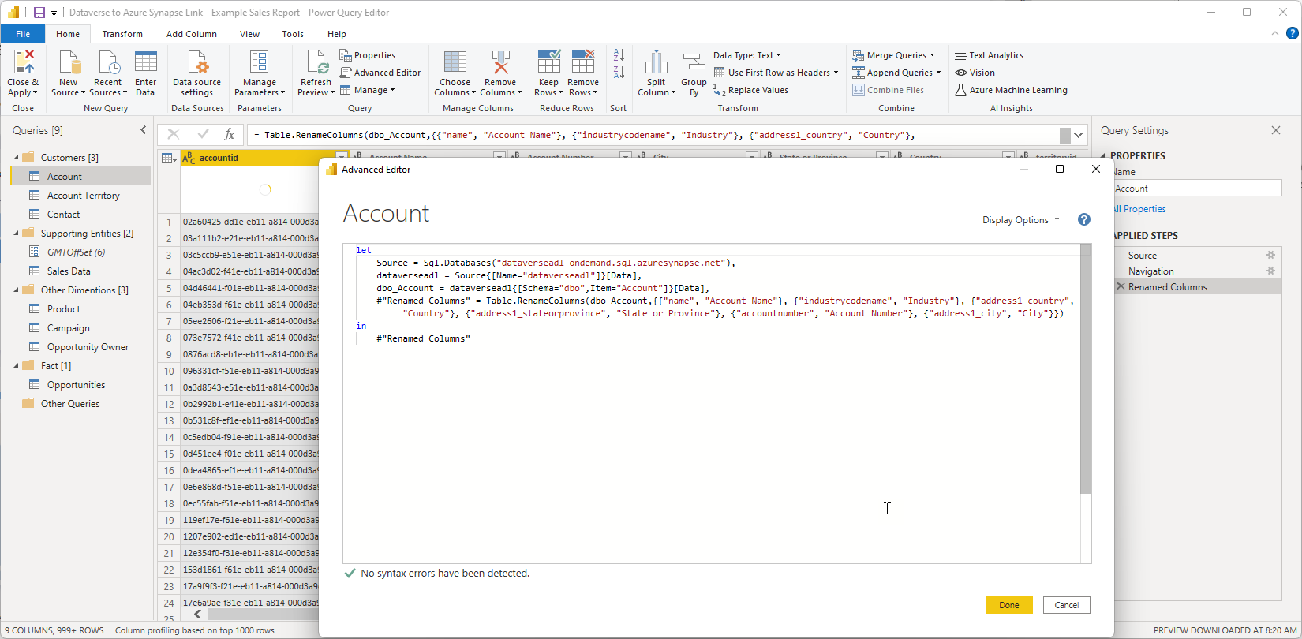
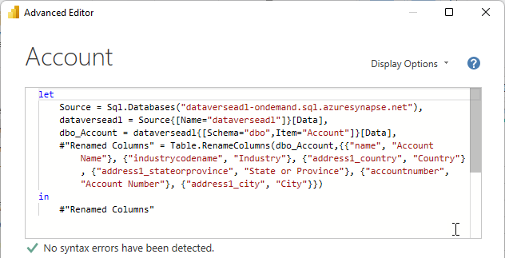
Connect Power BI to the new views

Slide 24
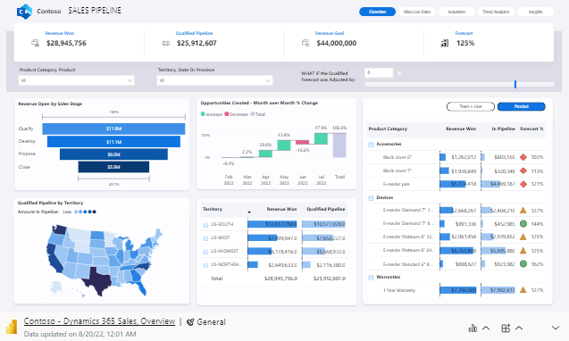
Completion of Basic Connectivity
Azure Synapse Link for Dataverse
Azure Synapse Analytics – ServerlessSQL
Auto-Created Views
Custom Report Views
Azure Data Lake Storage

Slide 25

Azure Synapse Link for Dataverse
Benefits:
Getting the Dataverse data to start flowing to the Azure Data Lake is a matter of clicks.
Considerations:
Azure Data Lake and Azure Synapse Analytics are billed on an Azure subscription.
Comes with a serverless SQL pool endpoint you can query with T-SQL.
Works as a data warehouse
Large volumes and complex query support in Synapse for additional data support and enrichment.
Once the data is out of Dataverse, the configured security model is lost (need to add Row Level Security).
If the customer hits Read/Write contention, there is a private preview for enabling an hourly snapshot for reading and other enhancements in the planning stage.
Date-Time is in UTC format

Slide 26
Thank You!

